Slide 1
Performance Analysis of Multiprocessor Architectures
CEG 4131 Computer Architecture III
Miodrag Bolic

Slide 2
Plan for today
Speedup
Efficiency
Scalability
Parallelism profile in programs
Benchmarks

Slide 3
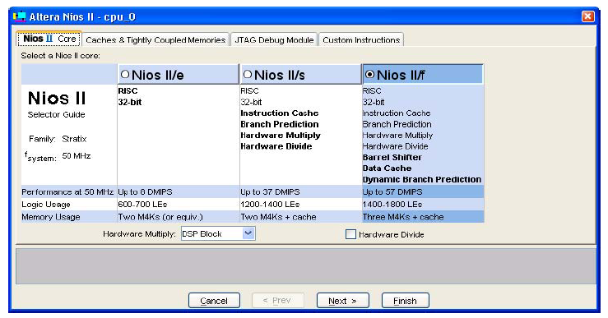
Terminology
What is this?
Notes:
T=Ic*CPI*Tclk, Ic is the number of instructions in a program, CPI is the number of cycles per instruction
For a given instruction set we can compute average CPI
MIPSrate=Ic/(T*10^6)
MIPSrate is based on the instruction mix which is very poor basis for performance comparisons because of instruction set differences.

Slide 4
Speedup
Speedup is the ratio of the execution time of the best possible serial algorithm on a single processor T(1) to the parallel execution time of the chosen algorithm on n-processor parallel system T(n):
S(n) = T(1)/T(n)
Speedup measure the absolute merits of parallel algorithms with respect to the “optimal” sequential version.

Slide 5
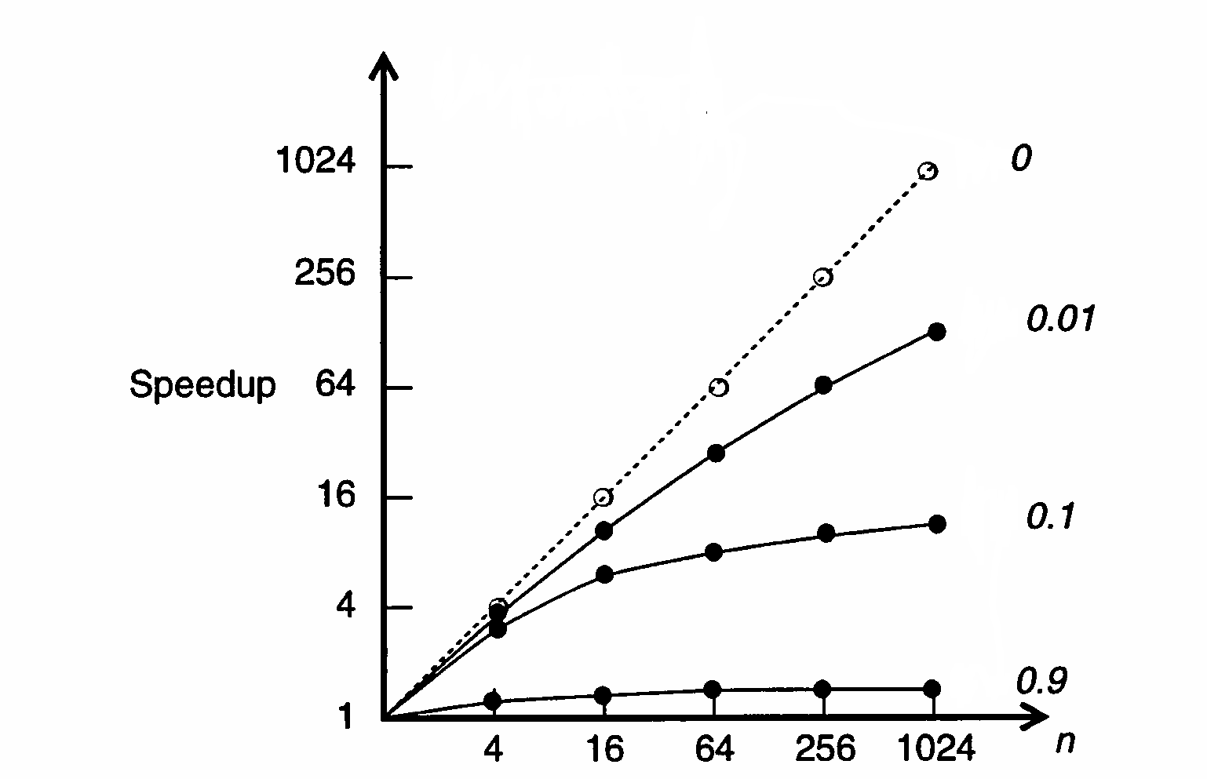
Amdahl’s Law [2]
β pure sequential mode
1 - β ~ a probability that the system operates in a fully parallel mode using n processors.
β
S = T(1)/T(n)
T(1)(1- β )
T(n) = T(1)β +
n
1
n
S =
=
β +
(1- β )
βn + (1- β )
n
Notes:
The system is either used in a pure sequential mode or in parallel mode using n processors
n->infinity, S->1/betta
The best speedup one can expect is bounded by 1/betta

Slide 6
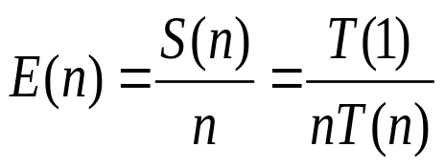
Efficiency
The system efficiency for an n-processor system:
Efficiency is a measure of the speedup achieved per processor.

Slide 7
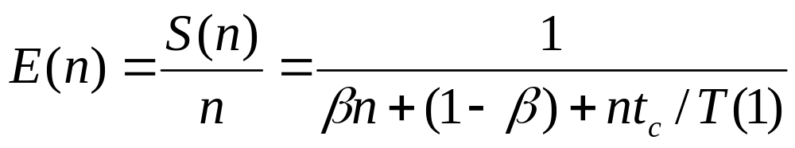
Communication overhead [1]
t_{c} is the communication overhead
Speedup
Efficiency
n
S =
βn + (1- β )+nt_{c}/T(1)

Slide 8
Parallelism Profile in Programs [2]
Degree of Parallelism For each time period, the number of processors used to execute a program is defined as the degree of parallelism (DOP).
The plot of the DOP as a function of time is called the parallelism profile of a given program.
Fluctuation of the profile during an observation period depends on the algorithmic structure, program optimization, resource utilization, and run-time conditions of a computer system.
Notes:
DOP defines the extent to which software parallelism matches hardware parallelism.
The execution of the program on parallel computer may use different number of processors at different time
Question: How would the parallelism profile look for Amdahl’s low?

Slide 9
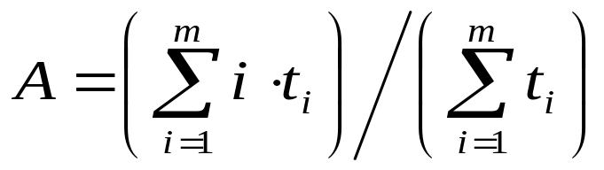
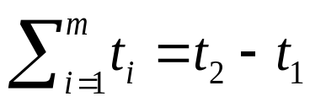
Average Parallelism [2]
The average parallelism A is computed by:
where:
  m is the maximum parallelism in a profile
  t_{i} is the total amount of time that DOP = i
Notes:
n>>m
Available parallelism: Computationally intensive applications: up to 3500 operations in a clock cycle
If the computation is less numeric, the available parallelism is smaller. Instructions level parallelism is only 2 to 5

Slide 10
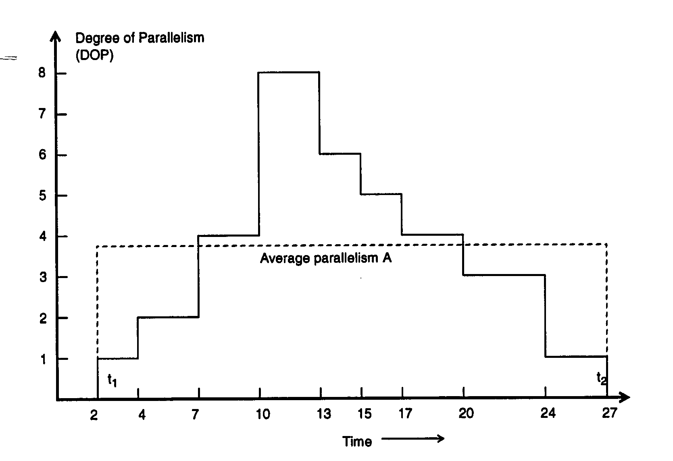
Example [2]
The parallelism profile of an example divide-and-conquer algorithm increases from 1 to its peak value m = 8 and then decreases to 0 during the observation period (t_{l}, t₂).
A = (1 × 5 + 2 × 3 + 3 × 4 + 4 × 6 + 5 × 2 + 6 × 2 + 8 × 3)/
/(5 + 3 + 4 + 6 + 2 + 2 + 3)=93/25= 3.72.

Slide 11
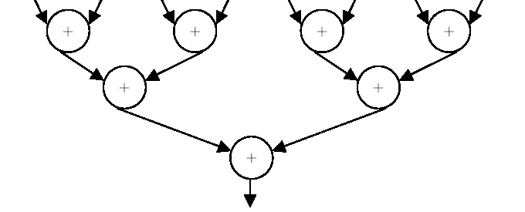
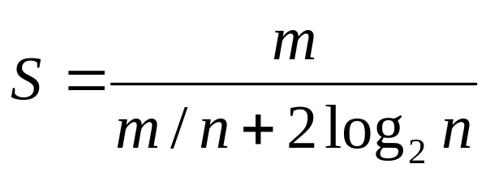
Scalability of Parallel Algorithms [1]
Scalability analysis determines whether parallel processing of a given problem can offer the desired improvement in performance.
Parallel system is scalable if its efficiency can be kept fixed as the number of processors is increased assuming that the problem size is also increased.
Example: Adding m numbers using n processors. Communication and computation take one unit time.
Steps:
  Each processor adds m/n numbers
  The processors combine their sums

Slide 12
Scalability Example [1]
Efficiency for different values of m and n
n m | 2 | 4 | 8 | 16 | 32
64 | 0.94 | 0.8 | 0.57 | 0.33 | 0.167
128 | 0.97 | 0.888 | 0.73 | 0.5 | 0.285
256 | 0.985 | 0.94 | 0.84 | 0.67 | 0.444
512 | 0.99 | 0.97 | 0.91 | 0.8 | 0.062
1024 | 0.995 | 0.985 | 0.995 | 0.89 | 0.76

Slide 13
Benchmarks [4]
A benchmark is "a standard of measurement or evaluation" (Webster’s II Dictionary).
Running the same computer benchmark on multiple computers allows a comparison to be made.
A computer benchmark is typically a computer program that performs a strictly defined set of operations - a workload
Returns some form of result - a metric - describing how the tested computer performed.

Slide 14
Benchmarks
Challenges in developing benchmarks
  Testing a whole system: CPU, cache, main memory, compilers
  Selecting a suitable sets of applications
  How to make portable benchmarks
  (ANSI C: How big is a long? How big is a pointer? Does this platform implement calloc? Is it little endian or big endian? )
Fixed workload benchmarks - how fast was the workload completed;
  EEMBC MPEG-x benchmark – time to process the entire video
Throughput benchmarks -how many workload units per unit time were completed.
  EEMBC MPEG-x benchmark – number of frames processed for the fixed amount of time
Some benchmarks
  Dhrystone
  SPEC
  EEMBC
Notes:
Indeed, the process for these newly released media benchmarks began nearly three years ago. At the earliest stages of development, selecting a representative
set of applications to sufficiently test the processors and systems under consideration provided the first challenge. The next challenge
involved determining how to make these benchmarks portable enough to run on the wide variety of processors and configurations that constitute the
targeted digital consumer applications.
Many popular benchmarks perform a fixed workload. Throughput benchmarks, on the other hand, have no concept of finishing a fixed amount
of work. Developers use throughput benchmarks to measure the rate at which work gets done.
Portability: The DENBench suite runs natively, directly on the processor hardware and without an operating system. Although this represents a deviation from
most real-world implementations, it supports portability because it eliminates any operating system dependencies or application-programming
interface issues.
C do you know if it is? Even if your application never
does any I/O, it’s not just the speed of the CPU that
dictates performance—cache, main memory, and
compilers also play a role—and different software
applications have differing performance requirements.
And whom do you trust to provide this information?

Slide 15
The Dhrystone Results
This is a CPU-intensive benchmark consisting of a mix of about 100 high-level language instructions and data types found in system programming applications where floating-point operations are not used.
The Dhrystone statements are balanced with respect to statement type, data type, and locality of reference, with no operating system calls and making no use of library functions or subroutines.
Dhrystone MIPS (sometimes just called DMIPS).
The program fits in a cache memory so that it cannot be used for testing caches

Slide 16
EEMBC [3]
The Embedded Microprocessor Benchmark Consortium’s (www.eembc.org)
Benchmarks
  telecommunications,
  networking,
  digital media,
  Java,
  automotive/industrial,
  consumer,
  office equipment products
Out-of-the-box portable code
  Cannot take advantage of a multiprocessing or multithreading system’s resources
Optimized implementations
  take advantage of hardware accelerators or coprocessors or special instructions
Notes:
Future: it will supprot multiprocessing embedded applications
Show the following:
Automotive -> Basic Integer and Floating Point
Digital entertainment -> RGB to YIQ Conversion

Slide 17
SPEC [4]
The Standard Performance Evaluation Corporation
www.spec.org/.
SPEC CPU2000 focuses on compute intensive performance, and emphasize the performance of:
  the computer's processor,
  the memory architecture,
  the compilers.
CINT2000 integer programs
CFP2000 floating point programs

Slide 18
SPEC
Features
  Benchmark programs are developed from actual end-user applications as opposed to being synthetic benchmarks (like gcc).
  Multiple vendors use the suite and support it.
  SPEC CPU2000 is highly portable.
The base metrics
  same compiler flags must be used in the same order for all benchmarks..
The peak metrics
  different compiler options may be used on each benchmark.

Slide 19
References
Advanced Computer Architecture and Parallel Processing, by Hesham El-Rewini and Mostafa Abd-El-Barr, John Wiley and Sons, 2005.
Advanced Computer Architecture Parallelism, Scalability, Programmability, by K. Hwang, McGraw-Hill 1993.
The Embedded Microprocessor Benchmark Consortium’s (www.eembc.org)
The Standard Performance Evaluation Corporation
www.spec.org/.

